Slide 1





RECOMMENDATION SYSTEM FOR MOVIES
Final Project
Group 1

Slide 2


TOPIC OUTLINE
Dataset/EDA
2. Data pre-prepocessing
3. Confusion Matrix
4. Evaluation/conclusion

Slide 3





DATASET / EDA

Slide 4

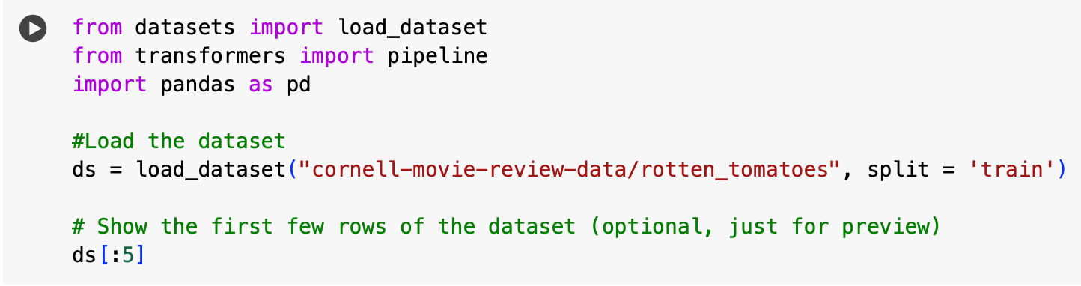


DATASET
Rotten Tomatoes is an American review-aggregation website for film and television

Slide 5

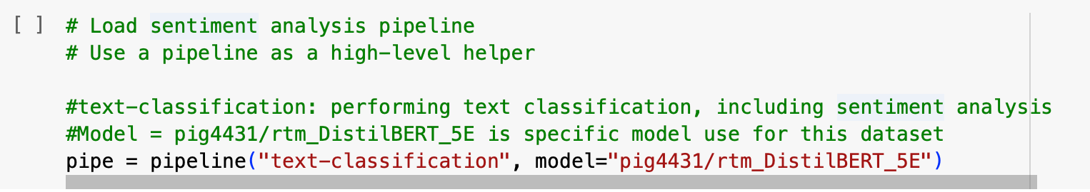
MODEL
Pre-trained model from Hugging Face
DistilBERT - In a movie recommendation system, it can process movie descriptions, reviews, or metadata to create embeddings, enabling personalized suggestions by matching user preferences with similar movies efficiently.

Slide 6




DATA
PRE-PROCESSING

Slide 7
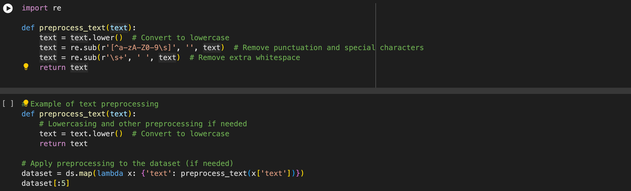
DATA-CLEANING
CHANGE TO LOWER CASE

Slide 8
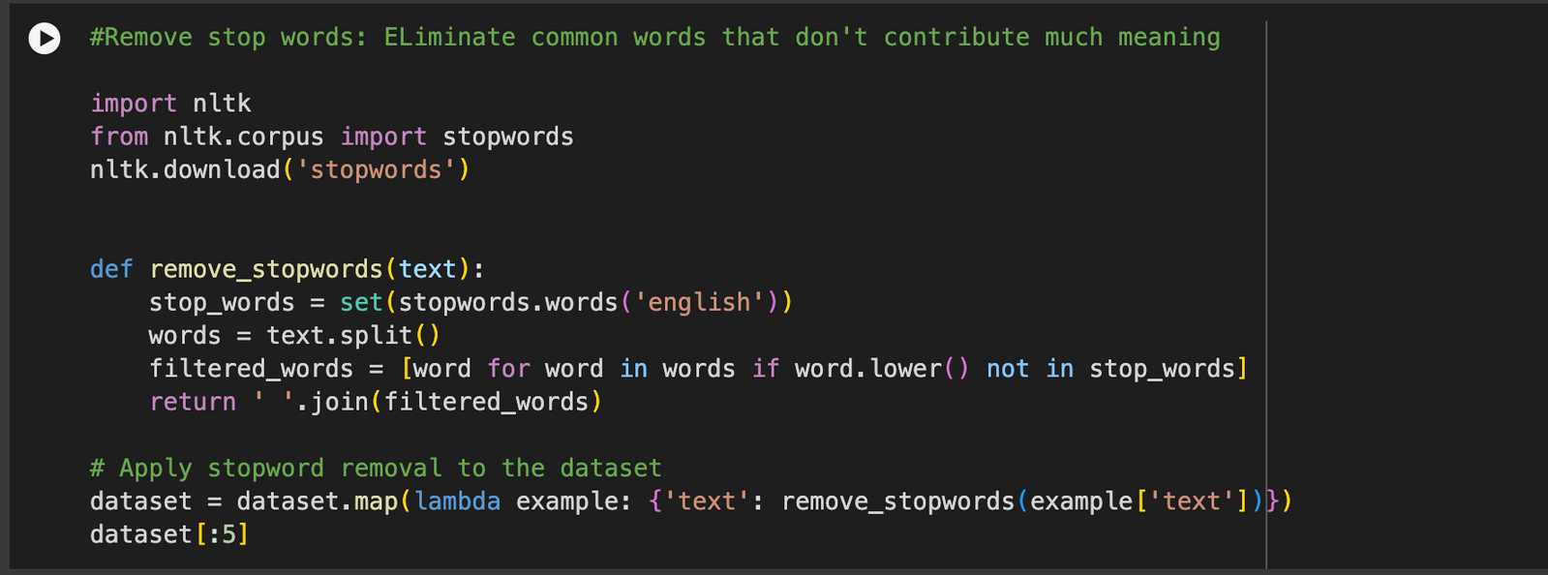
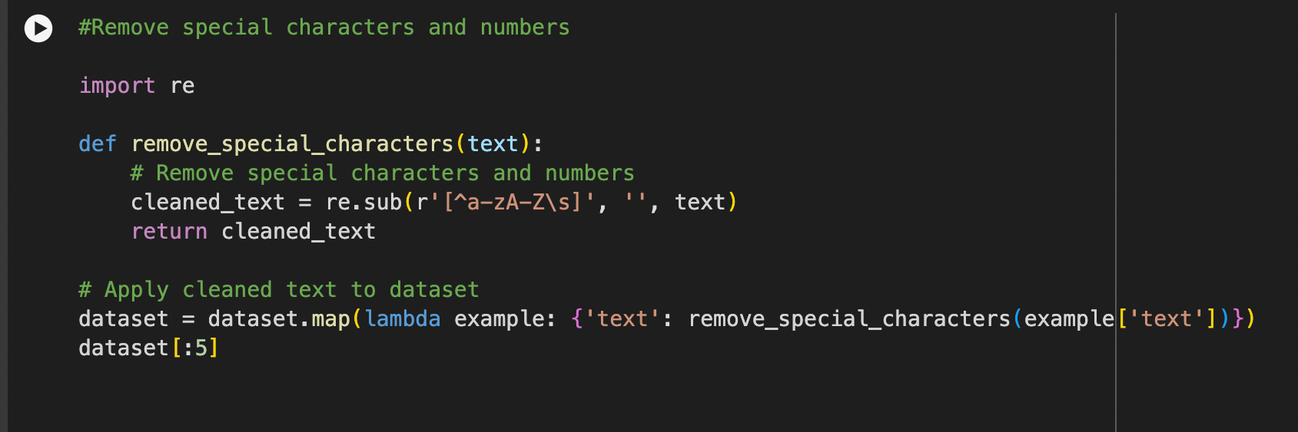
STOPWORD REMOVAL
SPECIAL CHARACTER AND NUMBER REMOVAL

Slide 9
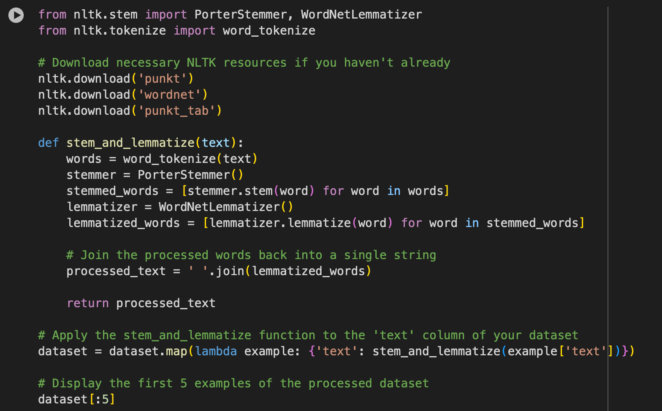
STEMMING AND LEMMATIZATION

Slide 10

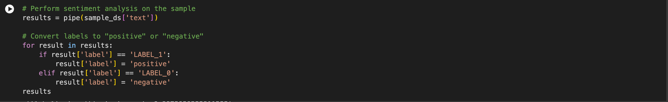
“4000 ROWS”

Slide 11
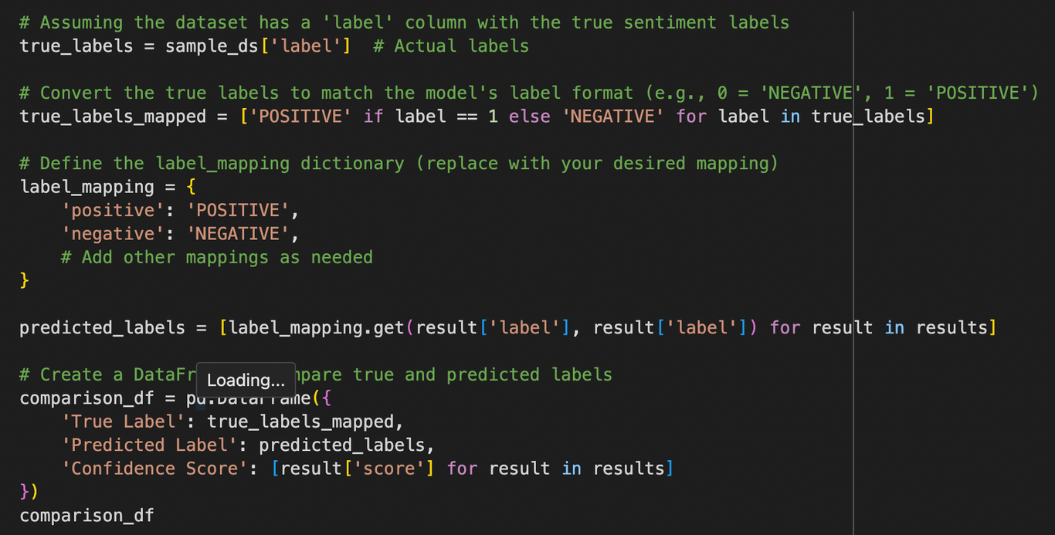
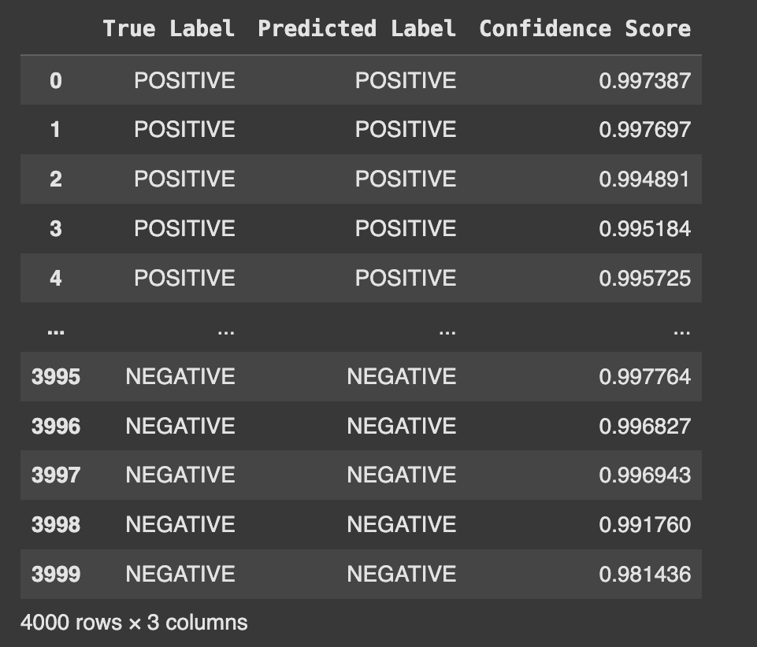
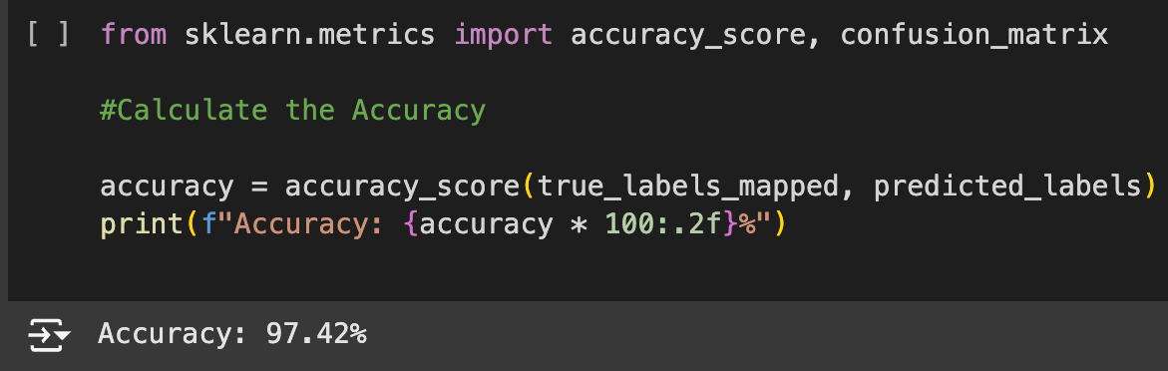
OUTPUT ->
ACCURACY%
97.42%

Slide 12


CONFUSION
MATRIX

Slide 13

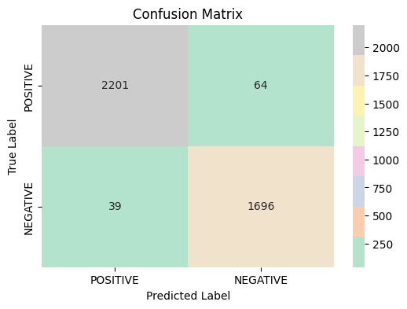

CONFUSION MATRIX
True Positive : 2201
2201 positive reviews were predicted as positive reviews
False Positive : 64
64 positive reviews were incorrectly predicted as negative reviews
False Negative : 39
39 negative reviews were predicted incorrectly as positive reviews
False Positive : 1696
1696 negative reviews were predicted correctly as negative reviews

Slide 14



EVALUATION

Slide 15

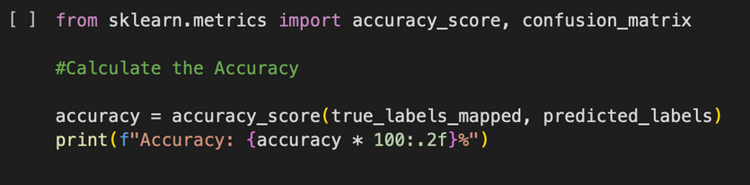
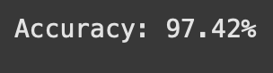
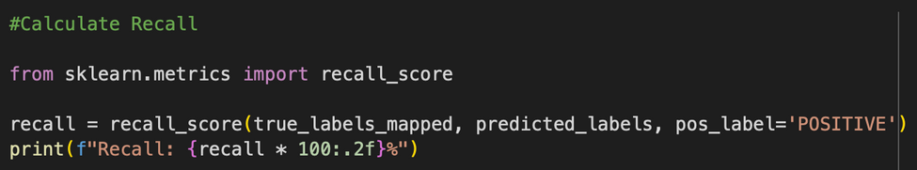
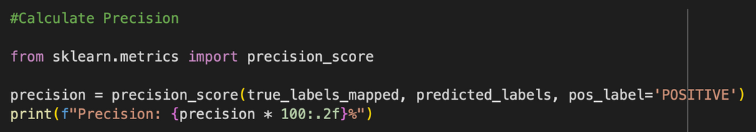

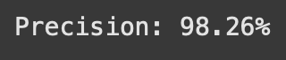
EVALUATION METRICS
Accuracy
Recall
Precision

Slide 16



PATTERN
2265
1735
POSITIVE reviews in total
NEGATIVE reviews in total
2201
1696
were correctly predicted
were correctly predicted
High numbers of true positive and negative value; therefore, well performance in detecting positive and negative reviews and low misclassification rate

Slide 17

DATASET BIASES
2265
1735
POSITIVE reviews in total
NEGATIVE reviews in total
2201
1696
were correctly predicted
were correctly predicted
The dataset shows a slight bias towards positive reviews, as there are more positive reviews (2,265) compared to negative ones (1,735). However, this minor imbalance is not a significant concern, as the evaluation metrics remain strong and indicate reliable performance.

Slide 18

CONCLUSION
The high number of accurately predicted positive and negative reviews highlight the model's effectiveness in sentiment analysis.
This indicates strong performance in detecting sentiments with minimal misclassification, supporting the model's reliability for practical applications.

Slide 19



THANK YOU FOR LISTENING
Don't hesitate to ask any questions!

